Slide 1
Theory of Change
Participatory workshop
Presented by

Slide 2
Agenda
Agenda

Slide 3
Introductions

Slide 4
My background
Presenter’s background

Slide 5
A pathway to evidence-based practice

Slide 6
Project stages
Stage 3
Standardised research and impact evaluation solutions
3
3
Stage 2
Evaluation framework / Roadmap for impact evaluation
2
Stage 1 - Current
Strategic impact review and ToC
1

Slide 7
Stage 1: Strategic impact review
Focus of this stage:
Review how [programme] activities [objectives]
Assess evidence and supporting research and theory to clarify pathways to impact
Highlight examples and evidence of programme impacts
Recommend ways to enhance programme impact
Notes:
Impact evidence can take many different forms.

Slide 8
Stage 1: Strategic impact review
Research design:
Complementary mixed methods approach
Quantitative: questionnaires with programme staff
Qualitative: questionnaires, interviews and participatory workshops
Data collection steps
Review of existing documentation
Scoping survey and fact-finding interviews with programme staff and representatives
Participatory workshops with programme staff and representatives

Slide 9
Stage 1: Strategic impact review
Key outcome from stage 1:
Mapping of impact pathways, expected outcomes, and relevant stakeholders
Develop theories of change at multiple levels:
Programme-level ToC
Selected project-level ToCs

Slide 10
Stage 2: Evaluation framework
The work begins where Stage 1 leaves off, building from the identified pathways to impact
Three main elements of this stage:
Clarification
Preparation
Finalisation
Key output: Evaluation framework spreadsheet summarising the audiences, delivery methods

Slide 11
Stage 2: Evaluation framework
This stage will clarify evaluation status:
Evaluation structures /methods /practices that are already effective, with no/minimal changes required
Aspects needing improvement
Missing aspects that need to be created from scratch
Notes:
Impact evidence can take many different forms.

Slide 12
Stage 2: Evaluation framework
Integrating the evaluation framework
Clarify what processes need to be established, by whom, and with what support systems
Planning practical details for integrating evaluation within programme delivery

Slide 13
Stage 2: Evaluation framework
Roadmap for bolstering evaluation across programme:
Identifying requirements for optimal structure for ongoing, high-quality evaluation
Detailed recommendations for enhancements
Evaluation design
Benchmarking
Training

Slide 14
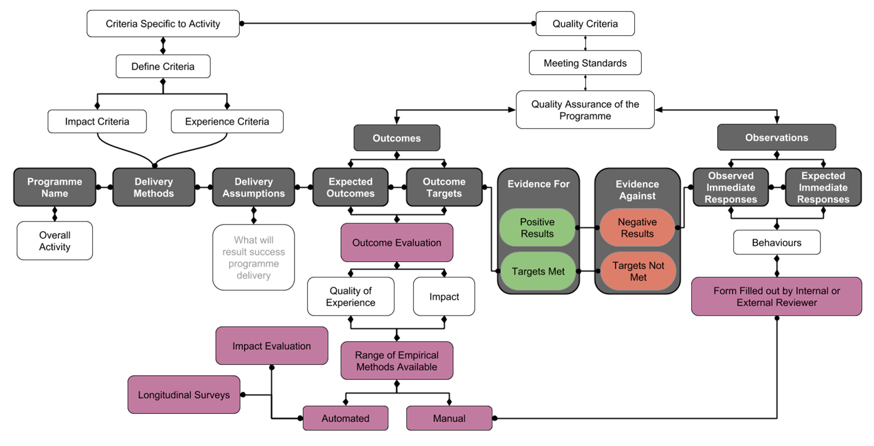
Example: Evaluation framework model

Slide 15
Stage 3: Evaluation framework implementation
Focus: Making the programme’s evaluation process efficient, impactful, and sustainable

Slide 16
Stage 3: Evaluation framework implementation
Key outputs
Digital data collection instruments and supporting systems
Data management solutions and analysis guidelines and processes
Training workshops and self-paced training resources
Templates and other practical documents and high-quality guidance videos

Slide 17
Discussion
Notes:
How can the theory of change be extended? Clarified? Improved?

Slide 18
STAGE 1:
Introducing
Theory of Change

Slide 19
Defining impact
Impact is “the good researchers do in the world” (The Research Impact Handbook)
Impact is the overall net outcomes or results of an activity (intended or unintended)
Impacts can be positive or negative
Notes:
Impact evidence can take many different forms.

Slide 20
Theory of Change
Crucial, often-overlooked early step in the evaluation design process
Orient and focus your evaluation
A comprehensive description of how and why the desired change is expected to happen in a particular context
Help you see where there may be gaps or missing steps on the pathway to developing targeted changes
Filling the 'missing middle' to clarify where the evaluation should be targeted

Slide 21
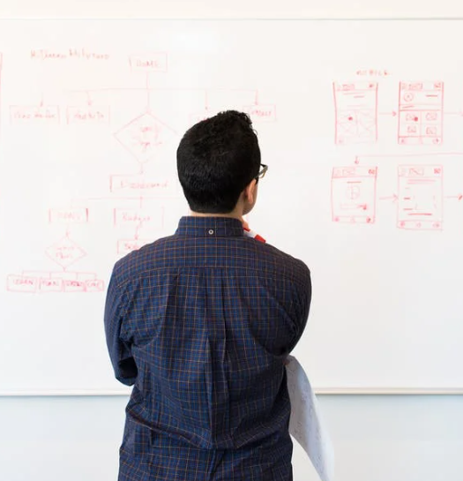
Good Theories of Change
Are SYSTEMATIC, showing step-by-step how you deliver impact
Shows how and why particular aspects of an impact plan are expected to deliver impact

Slide 22
Why develop a theory of change?
To clarify your impact plan
To select impact approaches that are likely to be effective (based on logic / evidence)
To reveal how you will achieve your impact objectives
To focus your evaluation where it is most needed

Slide 23
Clarifying / refining existing theories of change

Slide 24
Developing a
Theory of Change

Slide 25
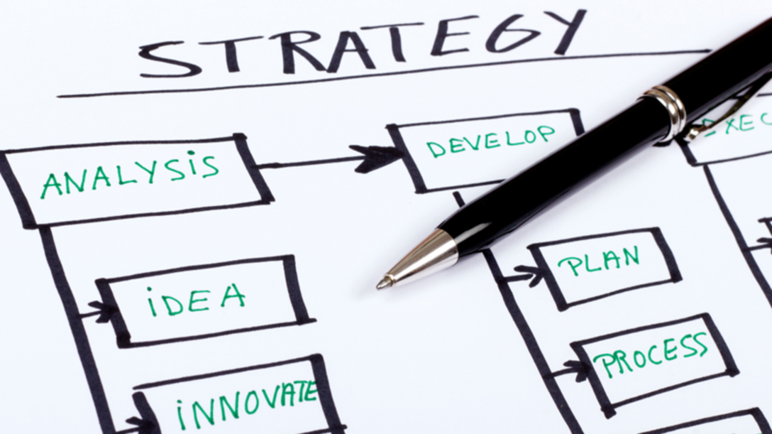
Notes:
Stakeholder analysis helps you to clarify the strategy for developing research impact. This includes many specific decisions.

Slide 26
Impact objectives
Think critically:
What impacts do you hope to achieve?
What change would you like to see as a result of your research?

Slide 27
Impact objectives
Think about the objectives for your impact:
Come up with an idea of the change you would like to see as a result of your research.
Prepare clear, unambiguous descriptions of the intended outcomes for your research.
Also think about how you will know if the outcome has been realised or change has happened.

Slide 28
Outputs vs outcomes
Outputs: direct products of program activities, may include types, levels and targets of services to be delivered by the program.
Outcomes: specific changes in program participants’ behaviours, knowledge, skills, status and level of functioning.
How might the person who attends the activity be different at the end of the experience?
How will they have changed?

Slide 29
Tip
Be very specific and explicit about any abstract concepts you’re trying to measure

Slide 30
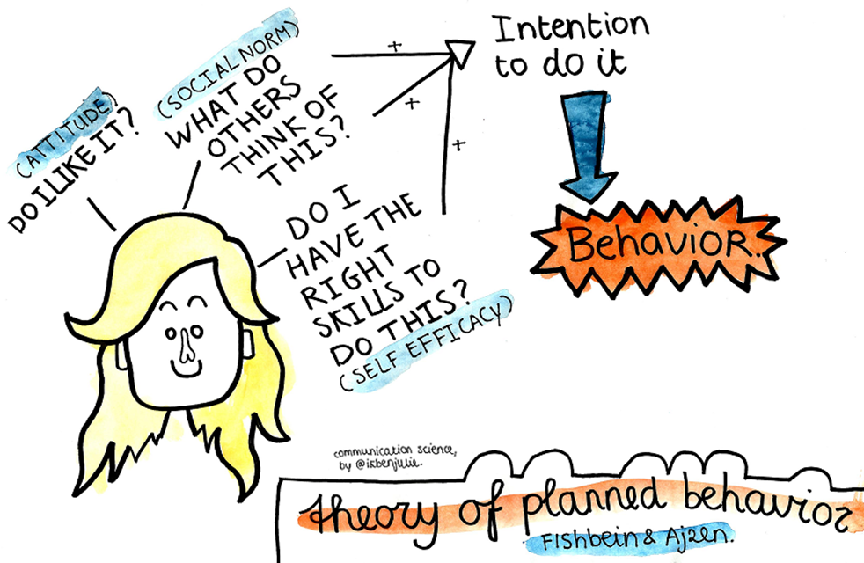
Theory of Change
Ask these questions:
What is the problem you are trying to solve?
Who is your key audience?
What is your entry point to reaching your audience?
What are the ultimate outcomes and/or impact you (and your stakeholders) want to see?
What steps are needed to bring about change?

Slide 31
Theory of Change
What alternative pathways might you be able to identify?
What is the measurable effect of your work?
What are the wider benefits of your work?
What is the long-term change you see as your goal?
Your evaluation design focuses on the pathways to impact identified in the theory of change

Slide 32
Co-producing a
Theory of Change
Bottom-up:
Stakeholder and partner identification
Complete impact planning templates with partners
Thematically group impact goals
Arrange impact goals in causal chains
Look back to activities in templates to further trace back to research

Slide 33
Co-producing a
Theory of Change
Top-down:
Check you have impact goals that intersect with your research questions
Identify missing impact goals, links in causal chains or research (e.g. using Theory of Change)
Check balance of activities across partners, themes, countries, etc.

Slide 34
Theory of change
What is the problem you are trying to solve? | Who is your key audience? | What is the entry point to reaching your audience? | What steps are needed to bring about change? | What is the measurable effect of your work? | What are the wider benefits of your work? | What is the long-term change you see as your goal?
Key assumptions | Key assumptions | Key assumptions | Key assumptions | Key assumptions | Key assumptions | Key assumptions

Slide 35
Making a difference through evidence-based research impact

Slide 36
Elements of a
Theory of Change

Slide 37
Theory of Change elements
Impact activities
Enabling factors
Intermediate and long-term outcomes
Overall outcomes

Slide 38
Impact activities
Specific actions or interventions designed to generate impact
Examples: workshops, meetings, school visits, etc.
They can be categorised by project stage (e.g., pre-project co-construction, dissemination, etc.)

Slide 39
Enabling factors
Resources supporting the success of engagement activities/achieving outcomes
Examples: adequate funding, supportive policies, skilled personnel, access to technology or infrastructure

Slide 40
Intermediate and long-term outcomes
Changes/results as a direct consequence of engagement activities and enabling factors
Clear interim progress toward achieving ultimate goals
Examples: increased awareness, improved skills, enhanced relationships

Slide 41
Overall outcomes
Ultimate changes or impacts that the theory of change aims to achieve
Reflect the broader objectives
Examples: improved community well-being, increased social cohesion, or sustainable policy impact on society

Slide 42
EXAMPLE
Center of Expertise for Waters (CREW) Impact Review
Investigated, showcased and explained how CREW projects developed impact
Created 'theory of change' diagrams to visually encapsulate the impact process
Analysed the data from interviews and participatory workshops
Created categories for impact activities, enabling factors, intermediate outcomes and actual benefits
Notes:
Share link to the CREW CSIR main report: https://www.dropbox.com/sh/zrq2l38nps986p2/AADHavSfOYTHiQMGnsyzOCHQa?dl=0.

Slide 43
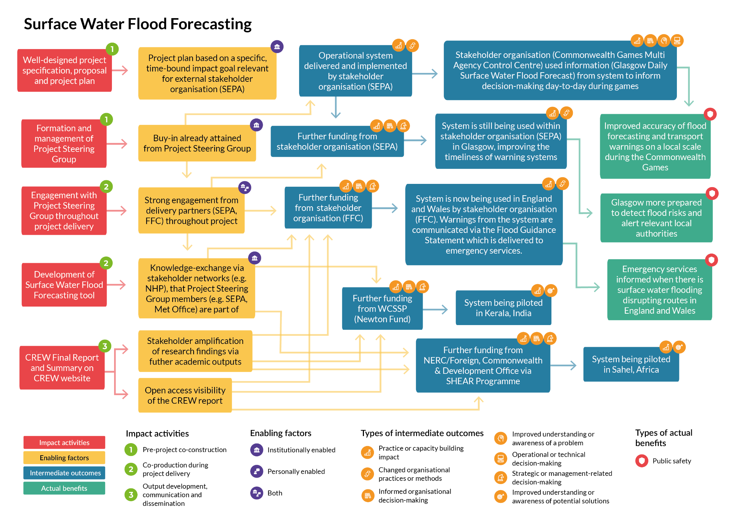

Slide 44
Developing the [programme]
Theory of Change

Slide 45
[Theory of change diagram]

Slide 46
Discussion
Notes:
How can the theory of change be extended? Clarified? Improved?

Slide 47
Next steps
Content

Slide 48
THANK YOU
Presented by

